Slide 1
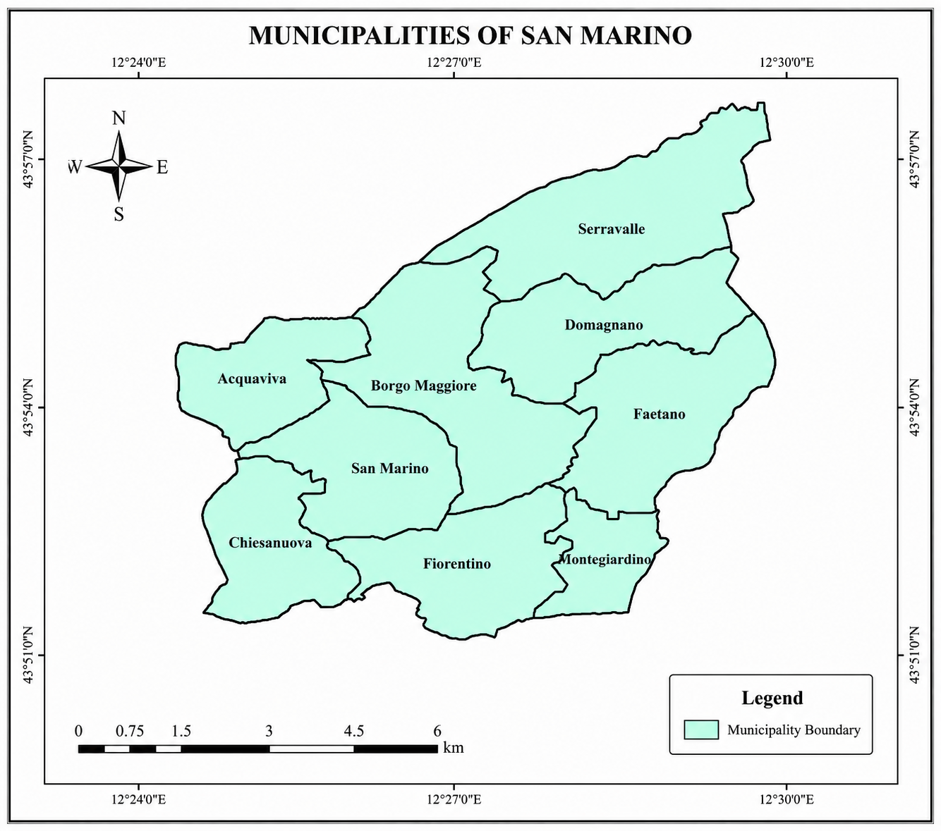
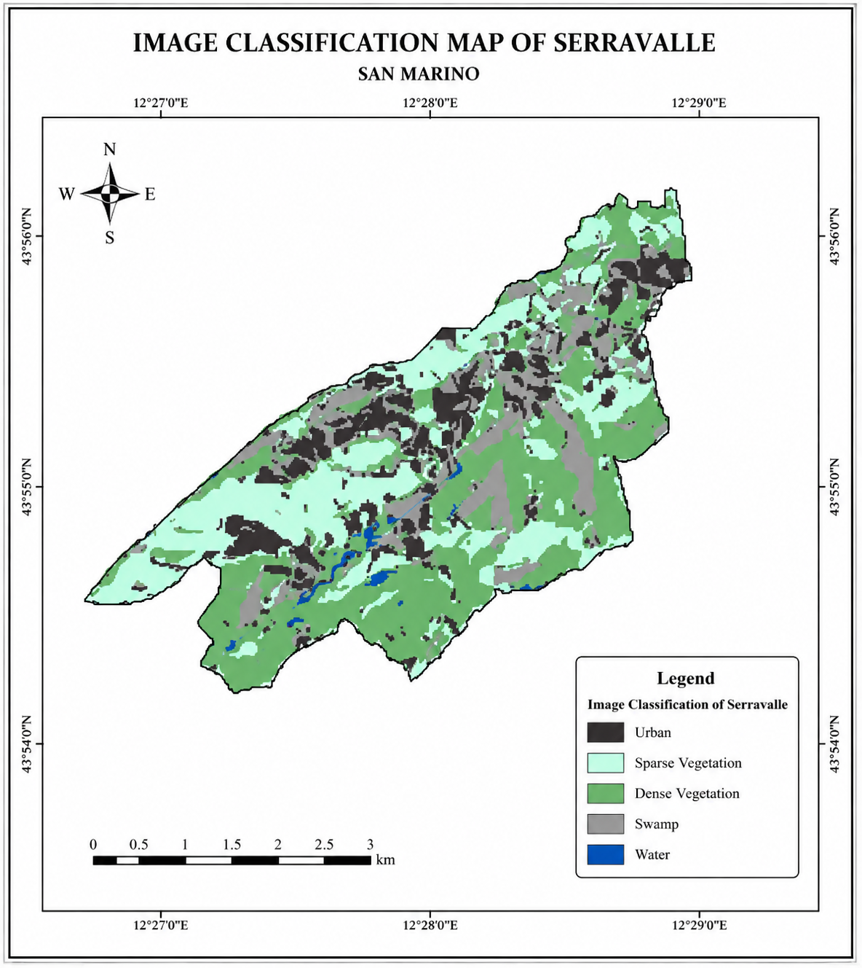
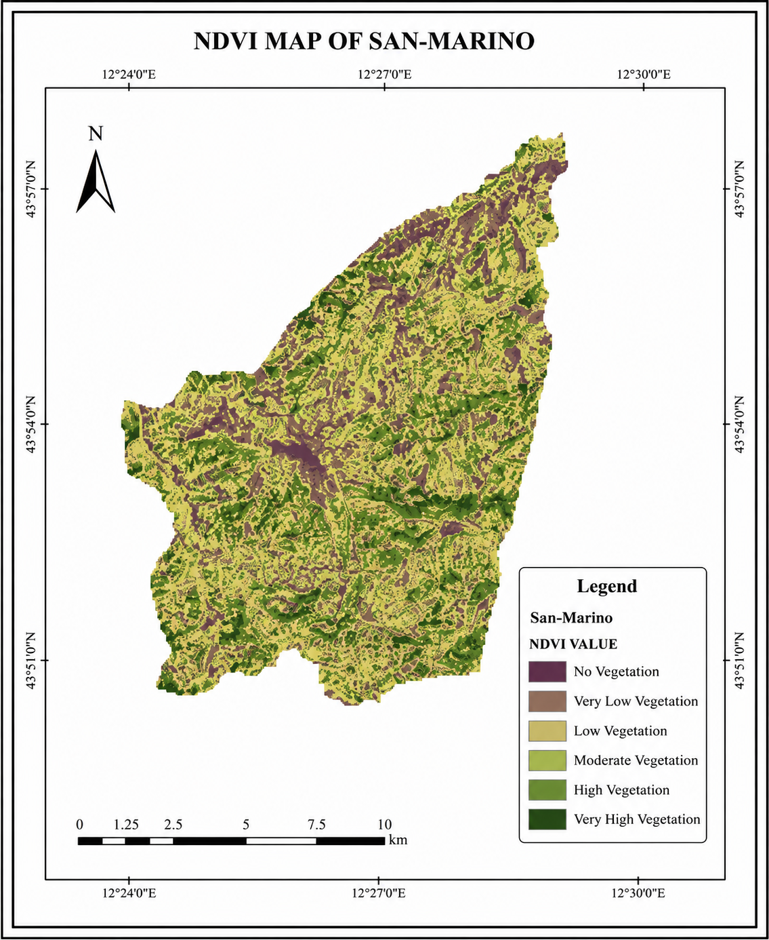
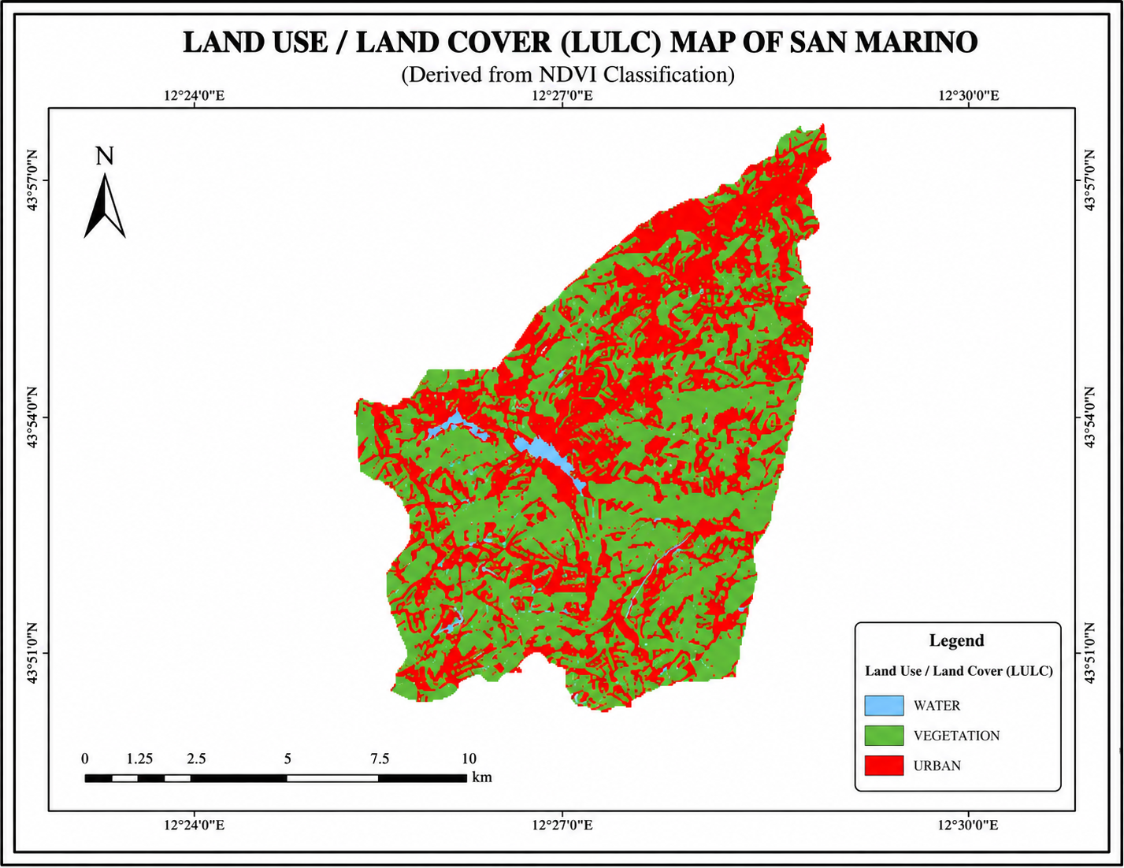
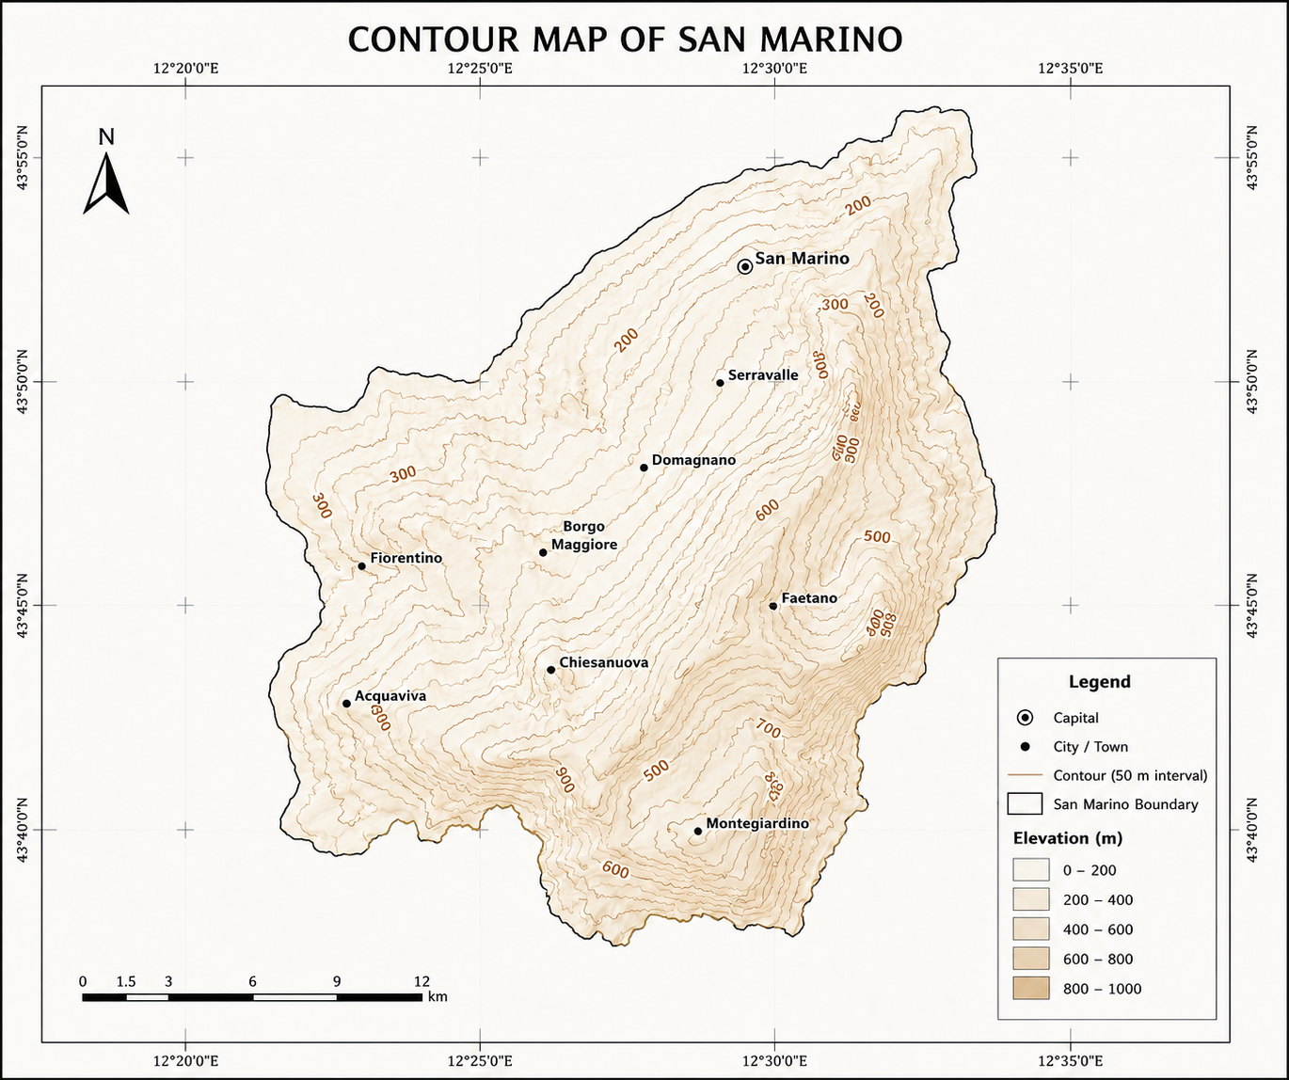
ENT 302
BASIC APPLICATION OF GIS (GEOGRAPHIC INFORMATION SYSTEM)
GIS APPLICATION IN ANALYSIS OF SAN MARINO THESE ANALYSIS INCLUDE
(DIGITIZATION,LAND USE/LAND COVER & VEGETATION,NDVI,IMAGE CLASSIFICATION
By: OYEWALE SAMUEL | Applied Geology, Federal University of Technology, Akure | Matric No: AGY/23/4284
Supervised by: Dr. Popoola
INTRODUCTION
Geographic Information Systems (GIS) are computer-based systems designed to capture, store, manage, analyze, and visualize spatially referenced data. By linking geographic location to descriptive attributes, GIS allows real-world features, boundaries, land cover, elevation, infrastructure, to be represented as discrete layers that can be queried, overlaid, and interpreted together. Core GIS operations include digitizing and georeferencing, spatial interpolation, image classification, buffering and overlay analysis, and cartographic output.
GIS is applied across virtually every sector that depends on location: urban and regional planning uses it for land-use zoning and infrastructure siting; agriculture relies on it for precision farming and soil mapping; disaster management uses it for flood, landslide, and wildfire risk modeling; public health uses it to track disease spread; and environmental management uses it to monitor deforestation, vegetation health, and climate impacts, exactly as illustrated later in this poster.
For geology specifically, GIS is an indispensable tool. It underpins geological mapping and stratigraphic correlation, mineral and hydrocarbon exploration through the integration of geophysical and geochemical survey data, terrain and slope analysis for landslide and erosion hazard assessment, hydrogeological modeling of aquifers and groundwater flow, and structural analysis through the interpretation of lineaments and fault patterns from satellite imagery and digital elevation models. As a 300-level Applied Geology student, this poster reflects hands-on training in these techniques, applied to San Marino as a compact, data-rich case study, ahead of their application to real subsurface and surface geological problems.
METHODOLOGY
STUDY AREA
Acquire administrative shapefile (municipality boundaries) and Landsat 8 OLI/TIRS imagery of San Marino, projected to WGS 1984 UTM Zone 33N
Digitize and georeference the nine municipal boundaries by heads-up digitizing, then clean topology (snap vertices, close gaps, remove slivers)
Perform supervised image classification on Serravalle using training signatures for 5 classes and a Maximum Likelihood classifier; validate with a confusion matrix
Compute NDVI as (NIR - Red)/(NIR + Red) from Bands 5 and 4, then reclassify into 6 vegetation-vigor classes using natural-breaks thresholds
Reclassify the NDVI raster into a 3-class Land Use/Land Cover (LULC) map (Water, Vegetation, Urban) using fixed NDVI thresholds
Interpolate elevation points into a contour surface at a 50 m interval and generate a hillshade-style elevation classification (0-1000 m)
Compute zonal area statistics per class for each output and apply consistent symbology, legends, and cartographic layout
Republic of San Marino (9 municipalities)
Municipality of Serravalle (image classification focus)
Full territorial extent of San Marino (NDVI & LULC analysis)
Fig. 1.0: Map showing the nine municipalities of San Marino
FINDINGS & DISCUSSION
Fig. 1.0 shows the digitized and georeferenced administrative boundary map of San Marino, delineating all nine municipalities (castelli): Acquaviva, Borgo Maggiore, Chiesanuova, Domagnano, Faetano, Fiorentino, Montegiardino, San Marino (Città), and Serravalle. Boundaries were digitized by heads-up tracing over a georeferenced base layer, projected to WGS 1984 UTM Zone 33N, and topologically cleaned to remove slivers and gaps between adjoining polygons.
Serravalle emerges as the largest and most populous municipality, occupying the northeastern lowland sector that borders Italy's Emilia-Romagna region, while Chiesanuova, Montegiardino, and Fiorentino form the smaller, more rural southern municipalities. San Marino City, seated on Monte Titano, is geographically central despite its modest area. This boundary layer is the base framework onto which the classification, NDVI, and LULC layers in Figs. 2-4 are subsequently clipped, joined, and cross-tabulated, so the positional accuracy achieved here directly governs the reliability of every downstream zonal statistic.
Fig. 2.0 shows the supervised image classification of Serravalle into five spectral classes - Urban, Sparse Vegetation, Dense Vegetation, Swamp, and Water - generated with a Maximum Likelihood classifier trained on representative signatures for each class and validated against reference points.
Approximate area shares are Dense Vegetation ~34%, Sparse Vegetation ~29%, Urban ~21%, Swamp ~11%, and Water ~5%. Urban pixels form a dense, interlocking network along the northeastern ridge and around the Dogana border crossing, reflecting Serravalle's role as San Marino's main commercial and industrial gateway. Dense vegetation dominates the steeper south-western slopes where terrain limits development, while the swamp class traces a narrow corridor along the valley floor, coinciding with a seasonal watercourse that also carries the small water bodies visible mid-scene.
This class-level breakdown provides the ground truth against which the coarser 3-class LULC map in Fig. 4.0 is later compared.
Fig. 2.0: Image classification map of Serravalle,
San Marino
Fig. 3.0 shows the Normalized Difference Vegetation Index (NDVI), computed as (NIR - Red)/(NIR + Red) from Landsat Bands 5 and 4, then reclassified into six vigor classes from No Vegetation (NDVI < 0.1) to Very High Vegetation (NDVI > 0.6) using natural-breaks thresholds.
The territory-wide mean NDVI is approximately 0.42, indicating overall moderate-to-high vegetation vigor. Moderate and High Vegetation classes together cover roughly half of the land area and dominate the southern and western hill slopes, while No Vegetation and Very Low Vegetation values are concentrated along the built-up ridge running from Borgo Maggiore through San Marino City to Serravalle, and in bare rock exposures near Monte Titano.
Because NDVI responds to both canopy density and soil moisture at the time of image capture, seasonal acquisition date should be reported alongside this map, as it can shift class boundaries by a full category in marginal pixels. The spatial pattern here anchors the vegetation/urban split later applied in the LULC reclassification (Fig. 4.0).
Fig. 3.0: NDVI map of San Marino
Fig. 4.0 shows the Land Use/Land Cover (LULC) map, derived by collapsing the NDVI raster into three fixed-threshold classes: Water (NDVI < 0), Urban (0-0.2), and Vegetation (>0.2).
Vegetation covers an estimated ~55% of San Marino's 61.2 km² land area, Urban surfaces ~43%, and Water under 2%, concentrated in a small reservoir visible near the central-western section of the territory. The fine, interlaced red-green pattern across the map, rather than large contiguous blocks, reflects San Marino's dense, terraced settlement pattern, where buildings, roads, and small garden or agricultural plots sit in close proximity across nearly every hillside.
Cross-checking this map against the five-class classification in Fig. 2.0 shows good spatial agreement: Serravalle's Urban and Sparse Vegetation classes both fall largely within this map's Urban threshold, while Dense Vegetation and Swamp map onto Vegetation. The main limitation is that a single NDVI threshold cannot separate bare soil or rock outcrops from true built-up surfaces, so localized misclassification is expected on exposed slopes near Monte Titano.
Fig. 4.0: Land Use/Land Cover (LULC) map of San Marino, derived from NDVI classification
Fig. 5.0 shows a contour map of San Marino generated by interpolating elevation points at a 50 m contour interval and classifying relief into five 200 m elevation bands from 0-200 m up to 800-1000 m.
Contours are widely spaced and elevations stay low (0-200 m) around Serravalle and the northeastern lowlands, then tighten sharply toward the interior, where San Marino City and the Monte Titano massif sit above 700 m, the republic's highest ground. The densest contour clustering, indicating the steepest slopes, runs along the eastern flank near Faetano and Montegiardino, while Acquaviva and Fiorentino in the west sit on a comparatively gentler mid-elevation shoulder around 300-600 m.
This terrain pattern explains the land-cover story built up in Figs. 2-4: the flat Serravalle lowlands were the easiest to urbanize and register as the largest Urban share in Fig. 2.0, while the steep, high-relief slopes around San Marino City and Montegiardino resisted development and instead retained the high NDVI and Vegetation classes seen in Figs. 3.0 and 4.0. Slope derived from these contours would be a natural next layer for a buildable-land suitability model.
Fig. 5.0: Contour map of San Marino (50 m interval)
CONCLUSION
This poster documents hands-on GIS training completed across five core workflows: administrative boundary digitizing and georeferencing, supervised image classification, NDVI-based vegetation index computation, Land Use/Land Cover reclassification, and contour/elevation interpolation, applied throughout to the Republic of San Marino as a compact, fully-covered case study.
Working through these five outputs built a working command of the full GIS pipeline: acquiring and projecting raw shapefile and Landsat imagery into a consistent coordinate system (WGS 1984 UTM Zone 33N); cleaning topology after digitizing; selecting and validating training signatures for a Maximum Likelihood classifier; deriving and thresholding a continuous vegetation index into discrete land-cover classes; and interpolating point elevation data into contour lines and elevation bands. Cross-referencing the five layers against one another, boundary, classification, NDVI, LULC, and contour, also built practical skill in spatial reasoning: recognizing why the flat Serravalle lowlands urbanized first while the steep slopes around Monte Titano and Montegiardino retained dense vegetation, and using terrain as the physical explanation for a land-cover pattern rather than treating each map as an isolated output.
As an Applied Geology student, these are the same techniques that underpin mineral exploration targeting, geological hazard mapping, terrain and slope stability assessment, and hydrogeological modeling, so this exercise is direct preparation for subsurface and surface geological analysis in later coursework and fieldwork. Continued practice with accuracy assessment (confusion matrices, ground-truthing) and the addition of slope and aspect layers derived from the contour data would be the natural next step in extending this skill set toward professional-grade geological GIS analysis.

